Slide 1
Course Title: Engineering Chemistry-1
Course Code: CHE109
(Chapter 11)
Dr. Joyanta Kumar Saha
Associate Professor
Department of Chemistry
Jagannath University

Slide 2
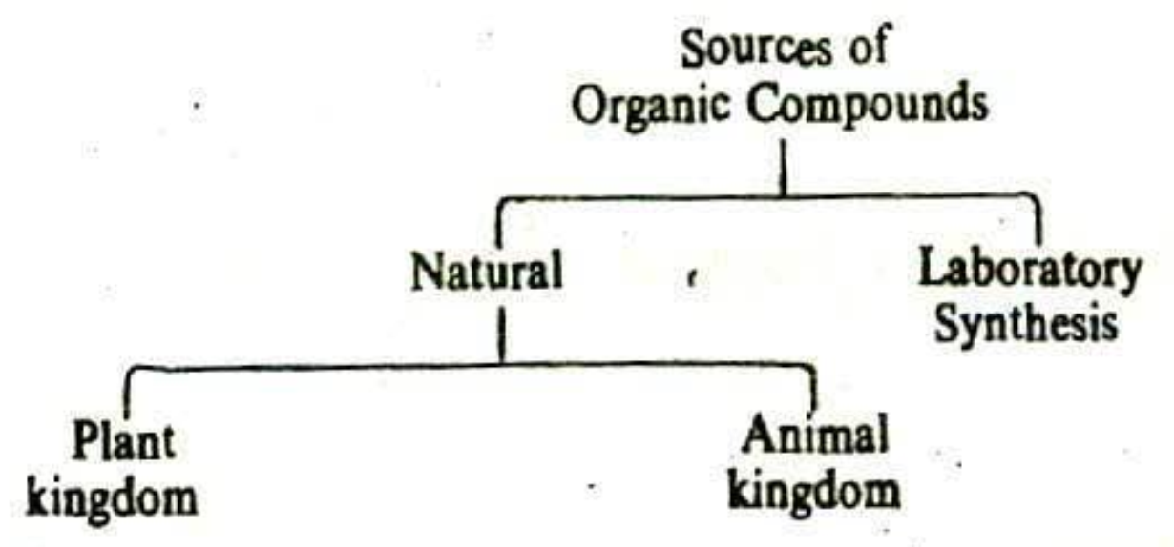
Organic Chemistry
The study of hydrocarbons and the compounds which could be thought of s their derivatives is defined as organic chemistry.

Slide 3
Importance of organic chemistry in modern life:
Application in daily life: Food, cloths, fuels, leather and wood, rubber and plastic.
Application in industry: Food, pharmacy, etc
Study of life processes:
Aliphatic compounds:
Alkanes: Alkanes are the simplest class of organic compounds. They are made of carbon and hydrogen atoms only and contain two types of bonds, C-H and C-C single covalent bonds. They do not have functional groups. Alkanes form a homologous series with the general formula CnH2n+2, where n is the number of carbon atoms. CH₄ (methane) and C₂H₆ (ethane). These compounds are also known as the saturated hydrocarbons.
The molecules of alkane are made of ccarbon atoms joined each to each by single covalent bonds while remaining valency bonds of carbons are linked to H atoms.

Slide 4
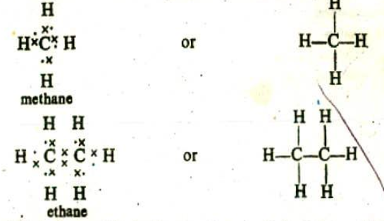
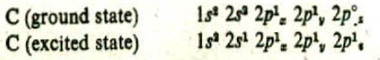
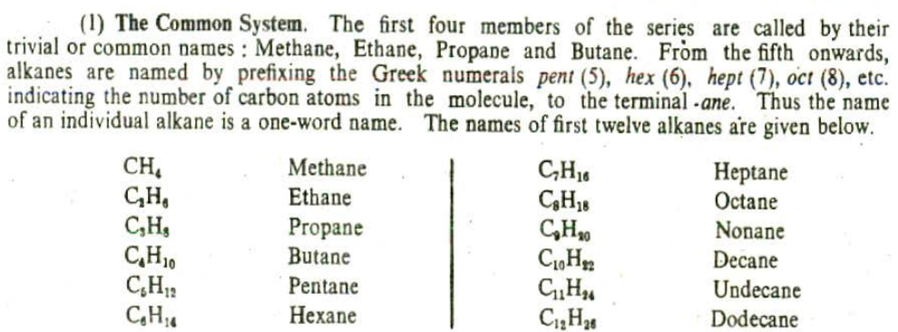
According to the modern orbital theory, the excited carbon atom has the electronic configuration
The 2S and three 2P orbitals in the excited state are hybridized to give four sp³ orbitals.
Nomenclature

Slide 5
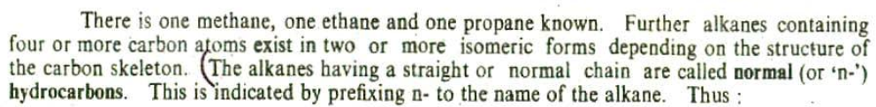
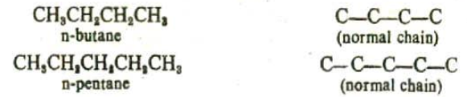
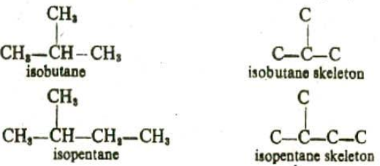

Slide 6
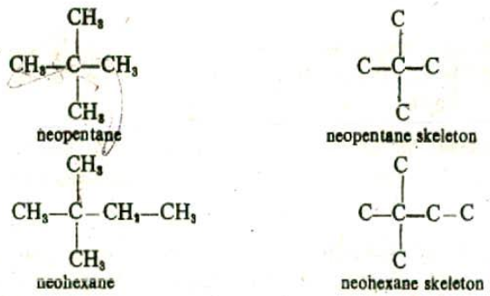
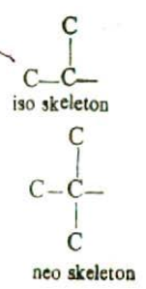

Slide 7
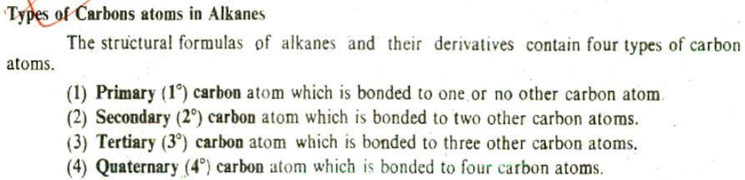
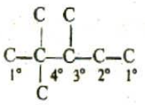
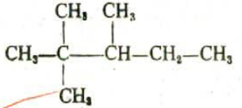

Slide 8
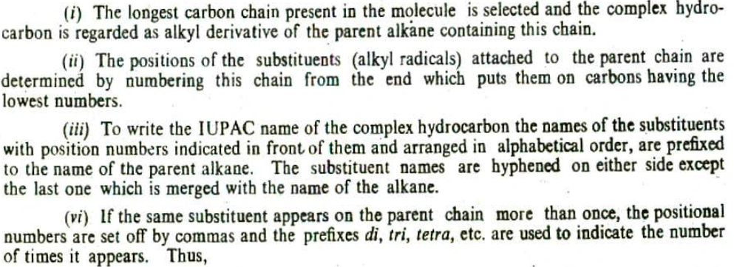
The IUPAC system

Slide 9
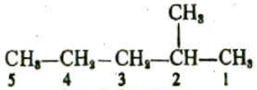
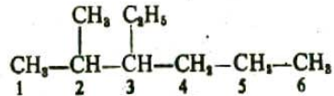
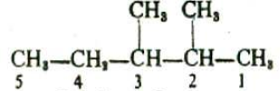
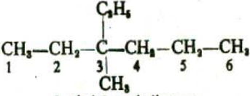

Slide 10
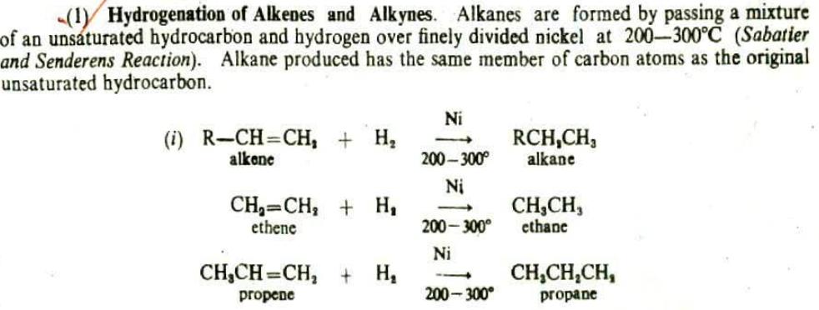
Preparation

Slide 11
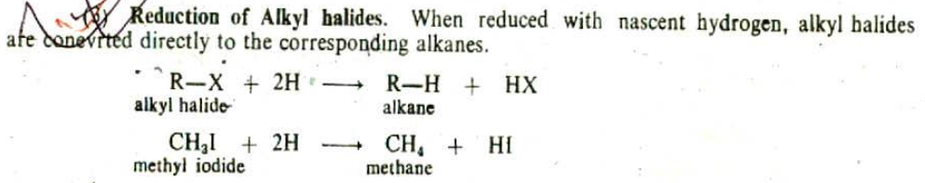
The Hydrogen for reduction may be obtained by employing Zn+HCl, C2H5OH+Na.

Slide 12
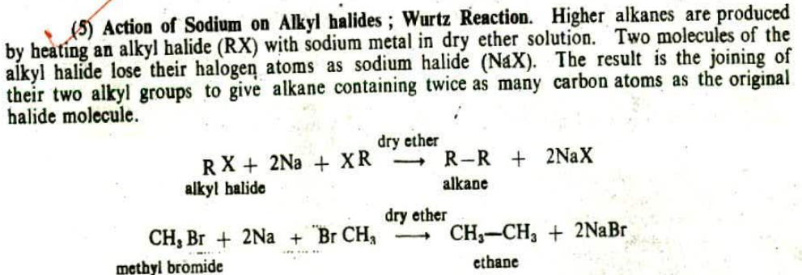

Slide 13
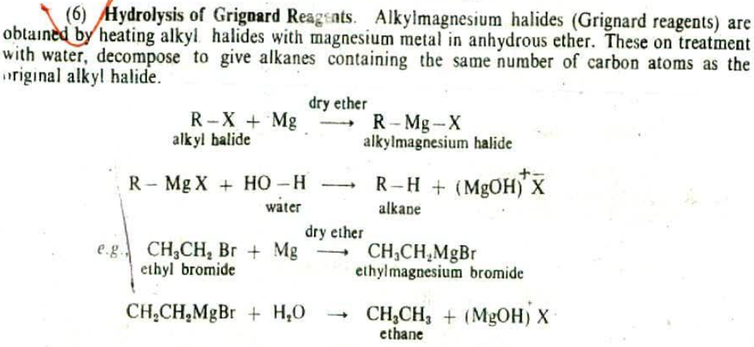

Slide 14
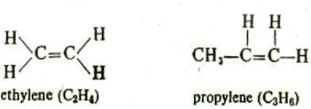
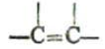
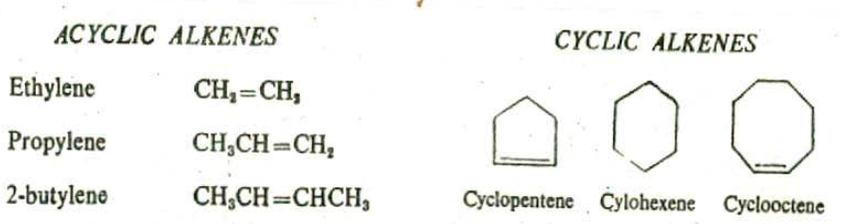
Alkenes: Alkenes are hydrocarbons those contain a carbon-carbon double bond (C=C) in their molecules. The general formula C_{n}H_{2n} (n=number of carbon atom) and designated as unsaturated hydrocarbons. They are commonly known as Olefines because the lower members form ‘oily’ products on treatment with chlorine or bromine. C₂H₄ (ethylene), C₃H₆ (propylene).
The functional group or function of alkene
Alkenes may be classified as Acyclic or Cyclic depending upon whether they have open chain or cyclic structure. A few examples of each class are given below.

Slide 15
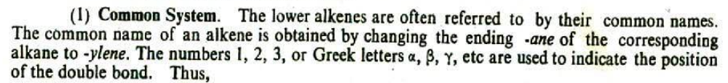
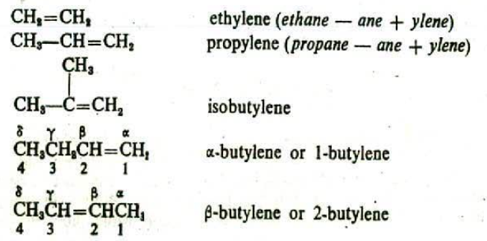
Nomenclature

Slide 16
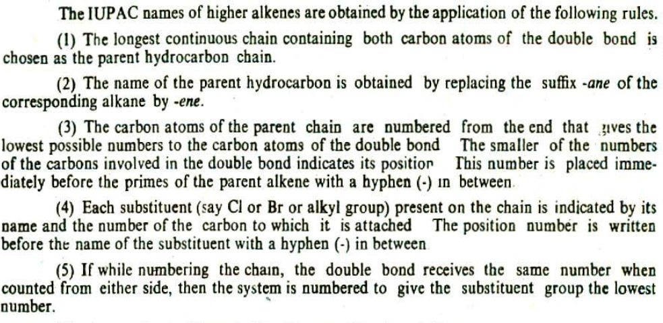
The IUPAC system

Slide 17
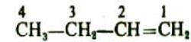
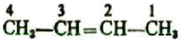
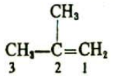
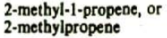
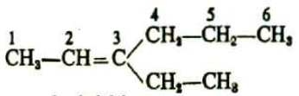
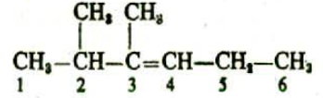
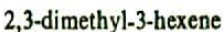

Slide 18
Preparation
By dehydration of alcohol: Dehydration means the removal of a molecule of water from a reactant molecule. When an alcohol is heated in the presence of sulphuric acid, a water molecule is eliminated and an alkene is formed. The ease of dehydration of an alcohol depends markedly in its structure. Tertiary alcohols dehydrate under mild conditions (moderate temperature, dilute acid). Secondary alcohols are intermediate in reactivity. Primary alcohols generally require concentrated acids and relatively high temperatures.

Slide 19
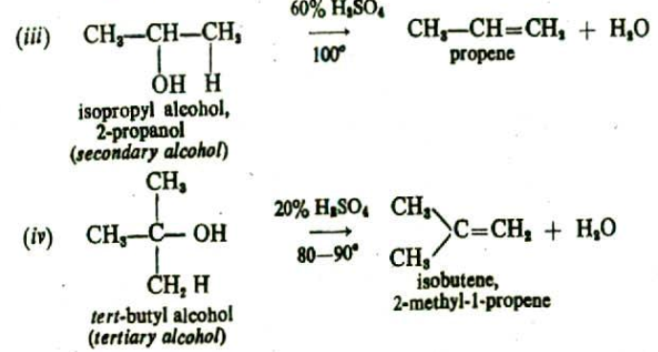
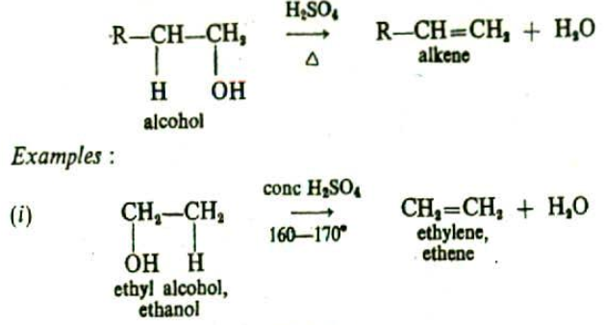
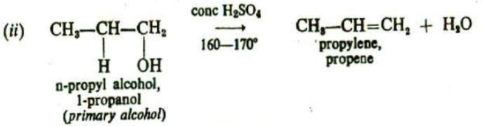

Slide 20
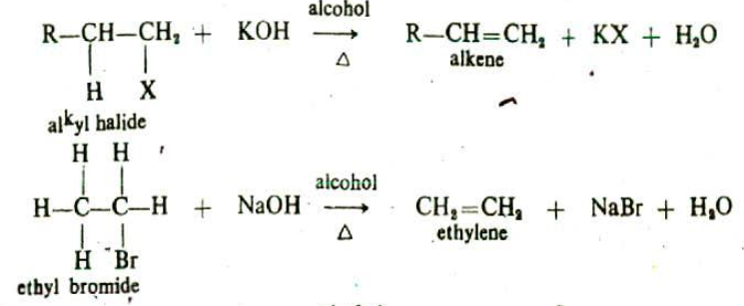
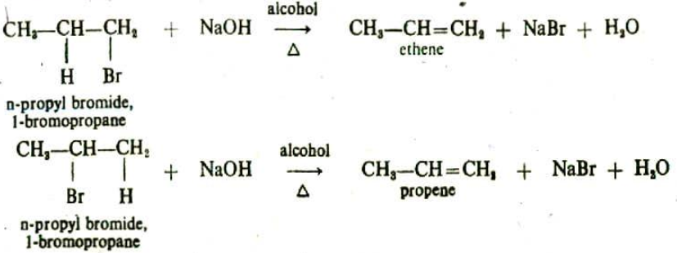
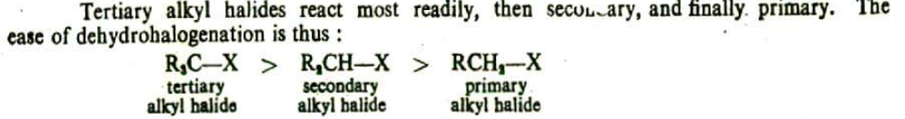
By dehydrohalogenation of alkyl halides: Dehydrohalogenation involves the removal of the elements of hydrogen halide (H—XI) from adjacent carbon atoms. When an alkyl halide is he with an alcoholic solution of sodium or potassium hydroxide, a molecule of hydrogen halide is eliminated and an alkene is formed. Alkyl bromides are more reactive than chlorides, and alky l iodides are still more reactive in undergoing dehydrohalogenation.

Slide 21
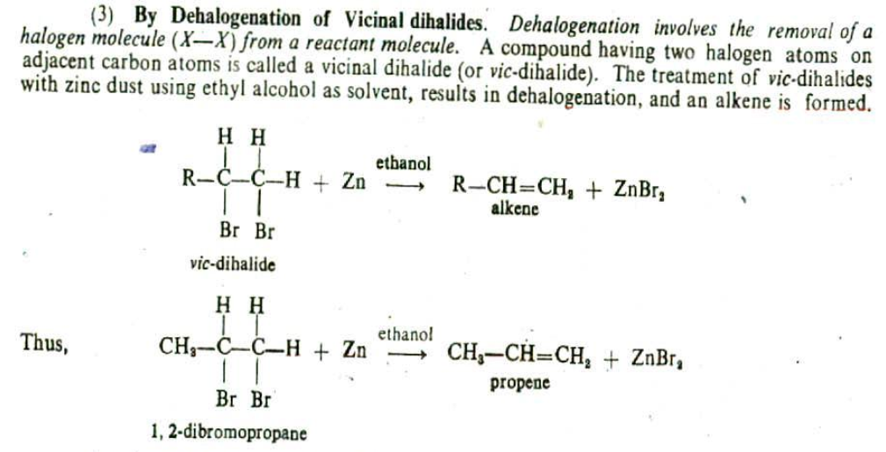

Slide 22
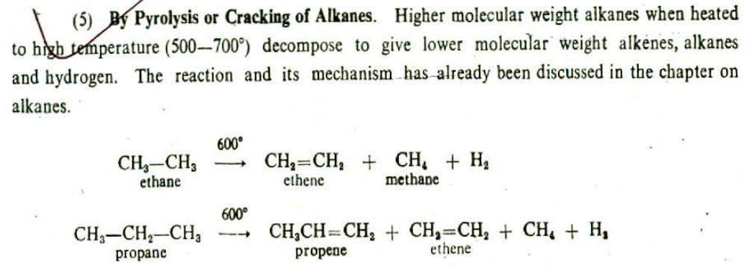

Slide 23
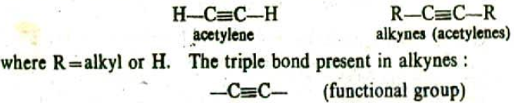
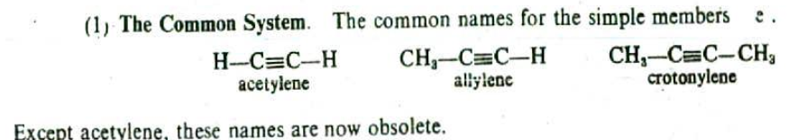
Alkynes: Alkynes are unsaturated hydrocarbons which contain a carbon-carbon triple bond (C≡C). The general formula of this class of compounds is C_{n}H_{2n-2}.
Nomenclature

Slide 24
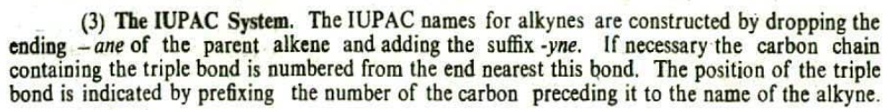
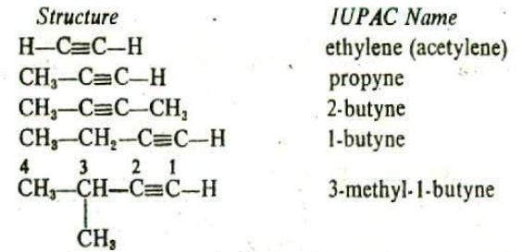

Slide 25
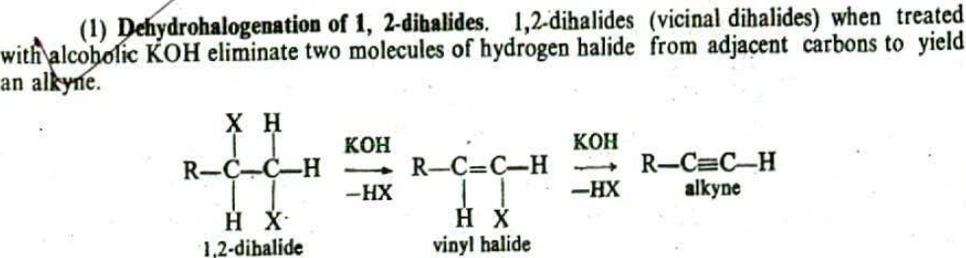
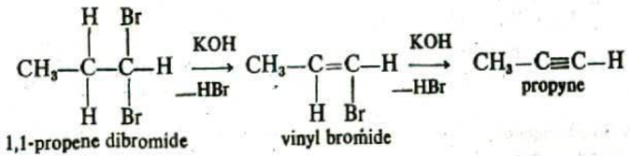

Slide 26
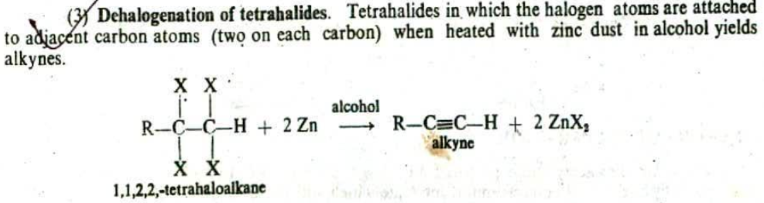

Slide 27
Aromatic Compounds
Besides the aliphatic compounds there were known since very early days of the history of organic chemistry, a large number of compounds having distinctly characteristic behavior. Such compounds were highly unsaturated and yet came to be known as very stable, Since most of them possessed pleasant odour, this new class of compounds were named as Aromatic Compounds.
Benzene and all other aromatic hydrocarbons which are structurally related to benzene, are now designated as Arenes. These are further subdivided into monocyclic, bicyclic and trincyclic arenes according to the number of six-carbon benzene structural units present in their molecule

Slide 28
Aromaticity of Benzene: We have already observed that benzene and numerous other structurally related compounds exhibit distinctly different physical and chemical properties as compared to aliphatic compounds. These benzenoid compounds even though highly unsaturated and possessing bonds, resist addition and oxidation reactions, and instead undergo substitution reactions. While the benzene ring, shows unusual stability, a substituent such as Cl, OH or NH₂, directly attached to the ring behaves very differently than the counterparts in the aliphatic series. Thus, the term 'aromatic character' or Aromaticity was adopted to signify the characteristic physical and chemical behavior of benzene and the related compounds.
The aromatic character was attributed to the presence of a planar, cyclic conjugated π bond system as in benzene. Thus, cyclic polyenes possessing alternate double and single bonds, with a planar carbon skeleton were shown to have aromatic character.

Slide 29
Modern Theory of Aromaticity: The fundamental concepts of this theory are:
The complete delocalization of n electrons of the ring systems makes them wholly aromatic in character. As seen in case of benzene, the delocalization of it electrons is caused by side-side overlapping of available p orbitals (each containing one electron) present on the carbons constituting the ring.
The ample delocalization of the π electrons is possible only if the ring is flat or coplanar, so as to allow cyclic overlap of p orbitals.
The bonding orbitals in the conjugated ring system should be completely filled. This requirement can be predicted by Huckel rule or 4n+2 rule. According to this rule, in a cyclic system of overlapping p orbitals if the number of n electrons is 4n+2, the system will have aromatic character, otherwise not. Here n0, 1, 2, 3 etc.

Slide 30
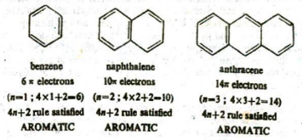

Thus: (a) benzene, naphthalene and anthracene containing 6, 10 and 14 π electrons respectively satisfy Huckel Rule and are aromatic.
(b) 1, 3-cyclobutadienc and 1, 3, 5, 7-cyclooctatetrene containing 4π electrons and 4π electrons respectively do not satisfy Huckel Rule and are nonaromatic.

Slide 31


IV. The cyclic systems formed by loss of a proton, which are ionic in character that obey Huckel rule also exhibit aromaticity. Thus cycloheptatrienyl (tropylium) cation, and cyclopentadienyl anion, both having 6c electrons (n=1) are aromatic. Even the cyclopropenyl cation which has 2π electrons (n=0) displays aromaticity.
V. Huckel enlarged the scope of his rule so as to embrace the heterocyclic ring systems as well. Thus, for pyridine and pyridiazine, n= 1. They have six π electrons each and satisfy Huckel rule and are aromatic.

Slide 32

VI. Huckel extended the application of his rule to non-benzenoid heterocyclic aromatic systems also with some modification. Thus, for furan, thiophene and pyrrole, n=1. Here, the heteroatoms contribute the nonbonded p orbital pair of electron lying inside the ring which is counted towards deciding the aromaticity of these compounds.
It may be noted that in each of above compounds there are four π electrons and two p electrons on the heteroatom inside the ring. Therefore, here the aromaticity is shown by compounds in which π electron system remains unchanged.

Slide 33


Nomenclature: In the IUPAC system, arenes of this class are named in a straight forward manner as substituted-benzenes. For example,
When there are two substituents on the benzene ring, then positions are indicated by numbers, or by the prefixes ortho (o.), meta (m-) and para (p.).

Slide 34


Preparation:
(I) From Alkynes: Benzene and many of its homologues can be prepared by polymerisation of appropriate alkynes. Acetylenes will polymerize at high temperature to yield arenes. Thus
(2) Decarboxylation of aromatic acids: Arenes can be prepared by heating aromatic acids or their sodium salts with sodalime.

Slide 35



(3) By Friedel-Crafts Reactions: Alkylbeazenes can be best prepared by the action of alkyl halides on benzene and its homologues in the presence of anhydrous aluminium chloride as catalyst. For example,
Friedel-craft alkylation: This reaction involves the introduction of an alkyl group in the benzene ring for the synthesis of alkylbenzenes which are not ordinarily available.
Friedel-craft Acylation: This reaction involves the introduction of an acyl group (RCO—) in the aromatic ring in the presence of anhydrous AlCl₃.

Slide 36

2) Hydrolysis of Aryl halides: Aryl halides yield phenol when hydrolysed with aqueous sodium hydroxide. For example, chlorobenzene is hydrolysed to phenol at high temperature and pressure by NaOH.

Slide 37

Elimination Reaction: Two or four atoms or groups attached to the adjacent carbon atoms in the substrate molecules are eliminated to form a multiple bond. A typical example is the dehydrohalogenation of the alkyl halides with alcoholic alkalis.
There are two kinds of elimination reactions:
a) Bimolecular elimination reaction (E2): When the rate of an elimination reaction is dependent both upon the concentration of a substrate and the nucleophile, the reaction is of second order and is represented as E1. E2 is a one step process in which the abstraction of the proton from the β-carbon and the expulsion of the leaving group i.e.. halide ion etc front the α-carbon atom occur simultaneously.

Slide 38

b) Unimolecular elimination reaction (E1): hen the rate of an elimination reaction is dependent only upon the concentration of the substrate and is independent of the concentration of the nucleophile, the reaction is of first order and is designated as E1. It is a two step processes. . The first step involves the slow ionisation of the alkyl halide to give the carbonium ion and the second step involves the fast abstraction of a proton by the base from the adjacent β-carbon atom leading to the formation of an alkane.

Slide 39


Addition reaction: This type of reaction is characteristic of (a) alkenes, alkenes, and (c) aromatic hydrocarbons. In fact, all organic compounds containing double or triple bonds display addition reactions.

Slide 40


